Slide 1



A-Eye: See beyond limitations

Slide 2

Team Members
Abdelaziz Salah
Abdelrahman Noaman
Khaled Hesham
Kirollos Samy
Supervised By : Dr. Yousef Ghattas

Slide 3







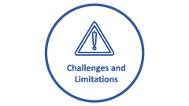

Agenda

Slide 4

Short story
How we got the Idea!

Slide 5

Motivation

Slide 6
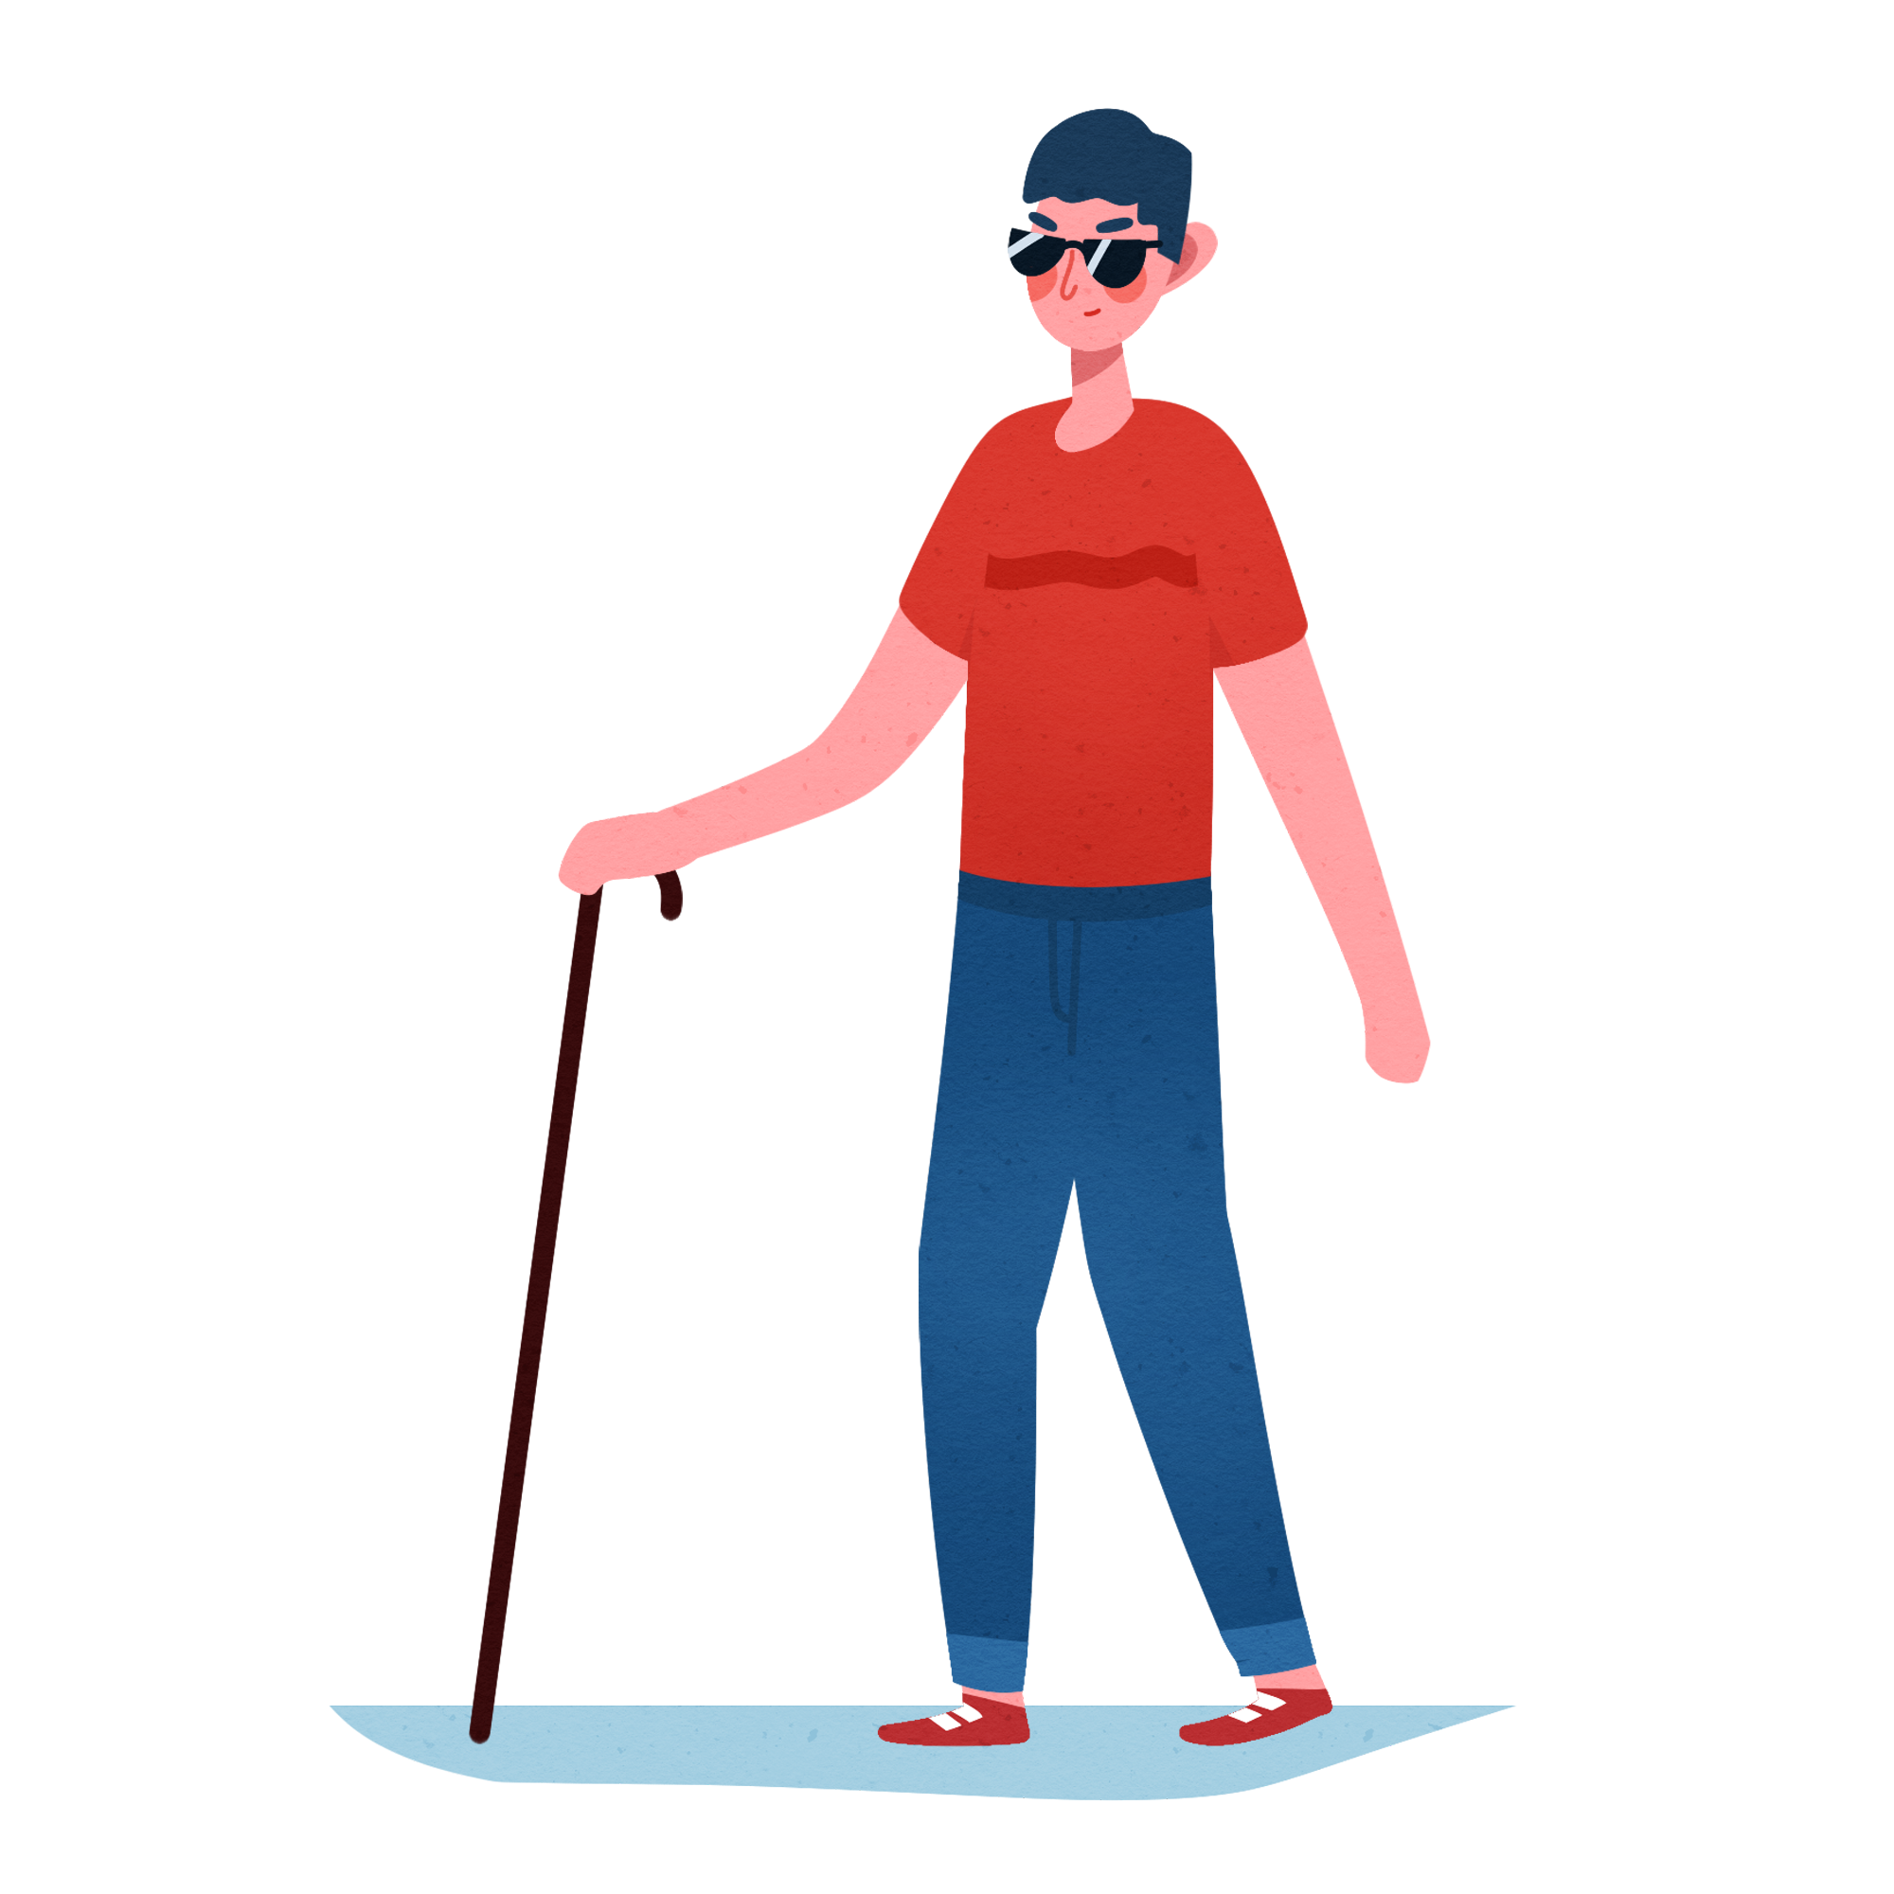
Motivation
“ Empowering the visually impaired people to seamlessly navigate and perceive the world around them. ”

Slide 7

Key facts
According to WHO:
About 2.2 billion people have a near or distance vision impairment.
There are 31% of them are born with vision impairment and turn into blindness.
This affect them as they face a lot of difficulties in all their life aspects.

Slide 8

Motivation
Navigating the world around you is an essential endeavor

Slide 9

Motivation
Navigating the world around you is an essential endeavor
Obstacles pose potential harm.

Slide 10

Motivation
Navigating the world around you is an essential endeavor
Obstacles pose potential harm to blind individuals, impeding their safe navigation in various environments.
Understanding the environment surrounding is a big matter that hardens lives of blind people

Slide 11

Motivation
Navigating the world around you is an essential endeavor
Obstacles pose potential harm to blind individuals, impeding their safe navigation in various environments.
Understanding the environment surrounding is a big matter that hardens lives of blind people
Being blind can make individuals vulnerable to deception by others who may take advantage of their visual impairment.

Slide 12

Market and Literature Survey

Slide 13
Survey
University of Zurich, Switzerland, 9 Dec 2022

Slide 14


Market Survey
providing advanced indoor positioning and navigation solutions.
integrated with iBeacons
It provides only navigation using a hardware devices
Cons: Expensive - needs pre-setup - limited to navigation
Notes:
https://duotone.shapefactory.co/?i=-HH3cGeAC4o&f=3fc7ff&t=2c0058&q=_
https://duotone.shapefactory.co/?f=3fc7ff&t=2c0058&q=_

Slide 15

Market Survey
provides indoor navigation assistance system.
integrated with I Beacons, and uses Bluetooth low energy (BLE).
Cons: Expensive - needs pre-setup – limited to navigation only
Notes:
https://duotone.shapefactory.co/?i=-HH3cGeAC4o&f=3fc7ff&t=2c0058&q=_
https://duotone.shapefactory.co/?f=3fc7ff&t=2c0058&q=_

Slide 16

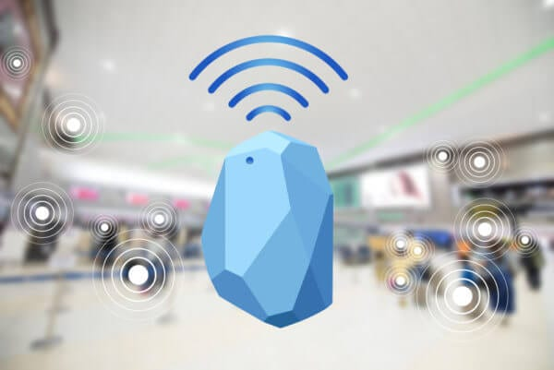
I Beacons
Protocol developed by Apple
Applied on hardware transmitter called beacons
They are BLE electronic devices.
They repeatedly broadcast their identifier to nearby portable electronic devices
Average price = 25$

Slide 17
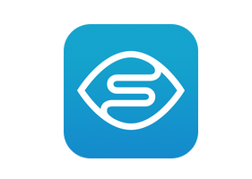
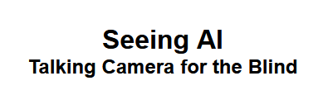
Market Survey
Provides a range of vision assistance tasks.
Describe the scene
speak text as it appears in front of the camera
Currency Identification
Cons:
No navigation features
No voice accessibility commands
Notes:
https://duotone.shapefactory.co/?i=-HH3cGeAC4o&f=3fc7ff&t=2c0058&q=_
https://duotone.shapefactory.co/?f=3fc7ff&t=2c0058&q=_

Slide 18

Features

Slide 19
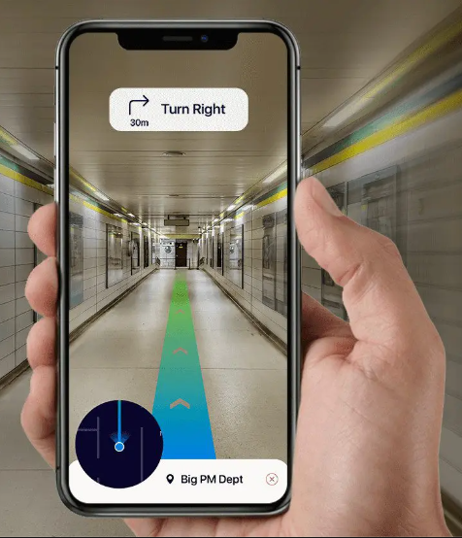
Features
indoor navigation system designed to empower visual impaired people.

Slide 20

Features
indoor navigation system designed to empower visual impaired people.
Obstacle Avoidance

Slide 21


Features
indoor navigation system designed to empower individuals with visual impairments
There are … … … in front of you!
Obstacle Avoidance
Scene Description

Slide 22

Features
indoor navigation system designed to empower individuals with visual impairments
Obstacle Avoidance
Scene Description
Reading Text

Slide 23
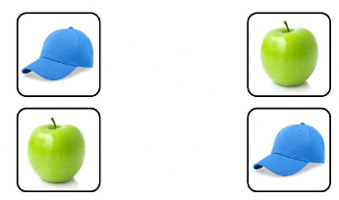
Features
indoor navigation system designed to empower individuals with visual impairments
Obstacle Avoidance
Scene Description
Object Matching

Slide 24
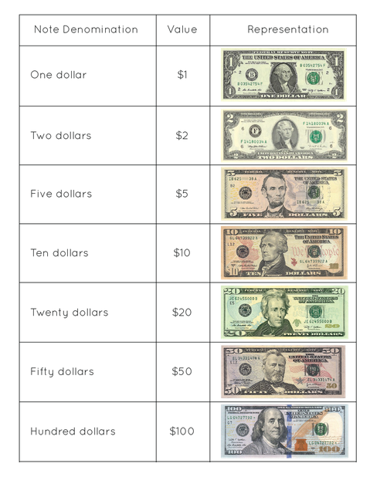
Features
indoor navigation system designed to empower individuals with visual impairments
Obstacle Avoidance
Scene Description
Reading Text
Object Matching
Identifying Currency

Slide 26

Application Accessibility
The User can use our application in two main ways:
Voice Commands

Slide 27

Application Accessibility
The User can use our application in two main ways:
Voice Commands
GUI with Voice over assistance

Slide 28
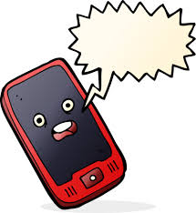
Application Accessibility
The System response will be voice.
Take care. go left.
This is the world!

Slide 29

System Architecture

Slide 30
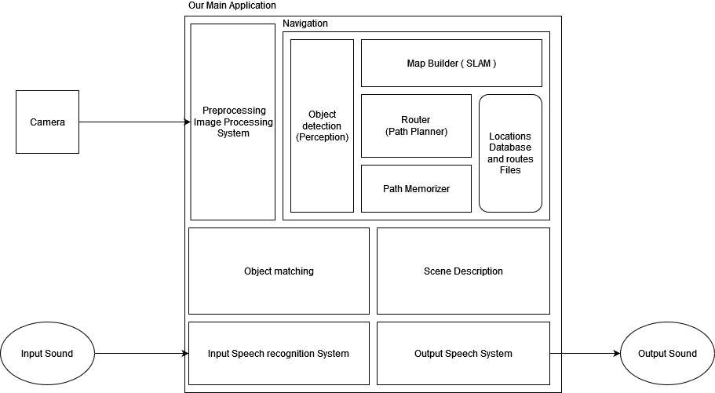
System Architecture

Slide 31

System Modules

Slide 32
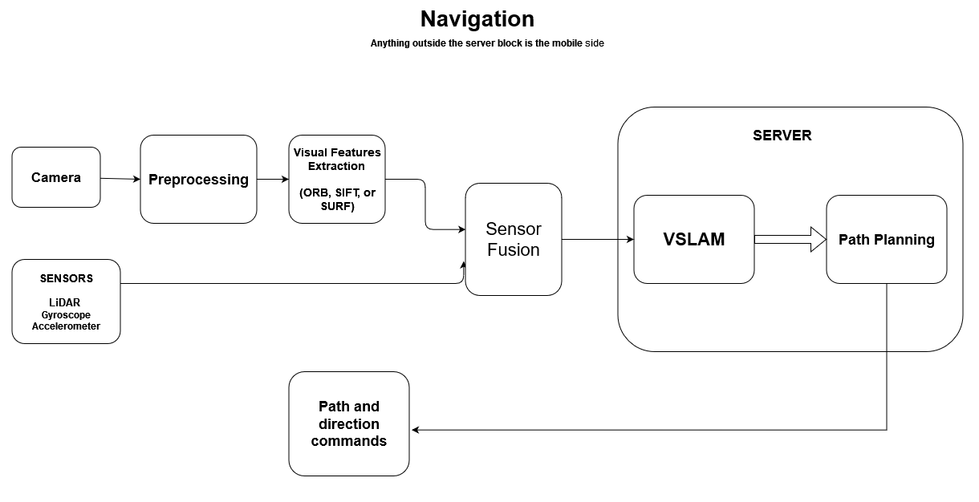
Navigation Module

Slide 33
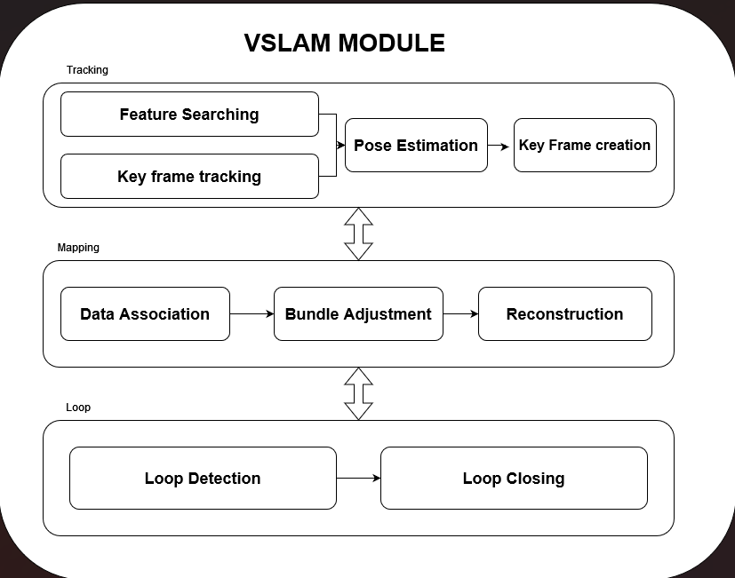
VSLAM Module

Slide 34
Object Matching Module
TODO

Slide 35
Scene Description module
TODO

Slide 36
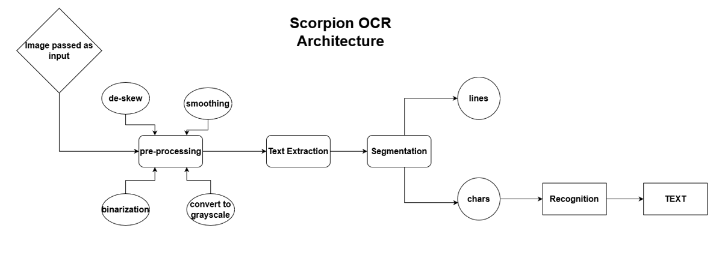
Optical Character Recognition(OCR)
OCR
Architecture

Slide 37

Challenges and
Limitations

Slide 38

Challenges
Person safety
Localization
Mapping
Object matching.
Scene Description
Accuracy and real-time response
Sensor precision
Usability.

Slide 39

Limitations
Server Response and Internet connection
Phone Type
Relying only on the phone without any support of any external sensors.
To apply the navigation, somebody must apply some landmarks for at least one time, then capture them to the blind person.

Slide 40

Conclusion

Slide 41
Conclusion
Our tool assists the visually impaired people using voice commands to easily
Navigate
Match Objects
Describe the scene

Slide 42

Future Work

Slide 43

Future Work
Apply outdoor navigation.
Add more vision features such as OCR and Currency identification.
Try to get better accuracy with relying on more external sensors
Performance optimization to decrease runtime.

Slide 44
Project Modules
Module | Abdelrahman Noaman | Abdelaziz Salah | Khaled Hesham | Kirollos Samy | Ready-made %
VSLAM
Object Matching
Scene Description |  |  |  |  | 80%
Mobile Application

